Slide 1

Investors Center
Dr. Akhilesh Das Gupta Institute of Technology & Management
CSE DEPARTMENT
MINOR PROJECT PRESENTATION
Under the guidance of :- Mr. Rishab Goel
Presented By :-
GURPREET SINGH( 35296202718)
MOHIT AGGARWAL (35496202718)
PARTH BHUTANI (41496202718)

Slide 2
Department of Computer Science & Engineering
VISION
To produce socially responsible technocrats, researchers , and entrepreneurs in the field of computer science and engineering.
MISSION
M1 -To provide quality education in the field of computer science and engineering with emphasis on research and innovations.
M2 - To inculcate professional behavior , strong ethical values, and leadership skills.
M3 - To provide a platform for promoting entrepreneurship and multidisciplinary activities.

Slide 3
Content
Objective
Introduction/Literature survey
Methodology with Block Diagram
Nature of Project: S/W, H/W
Final Application.
Name of three SCI/Scopus indexed journals or IEEE conference in one of which work will be published

Slide 4

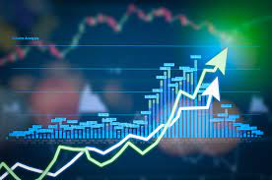

OBJECTIVE
One Stop for all your investment needs , investors centre is the corner stone of every and any type of financial investment which involves participative risk and yields magnanimous returns on investments . this project helps the client in investing his/her money on the basis of calculative risk. On analysing the data from the past the models used helps to predict the future price thereby the user can decide whether to invest or not.

Slide 5
Introduction
Gone are the days when people use to only rely on their savings for future security. In today's world, savings may not be adequate to ensure financial safety. Investing ensures present and future financial security. It allows you to grow your wealth and at the same time generate inflation-beating returns. You also benefit from the power of compounding. Furthermore, investments have the potential to meet your financial goals, such as purchasing a house, accumulating retirement corpus, and building an emergency fund, among others.Today there are various fields in which one can invest whether it’s gold, crypto currency, variety of stocks. But the questions arises how safe it is to invest your money? What will that Investment yield for you in the future? Does it worth investing all your hard earned money into any particular stock?We can find answer to all these questions using the advance field of Machine learning. Machine learning as technology helps analyse large chunks of data, easing the tasks of data scientists in an automated process and is gaining a lot of prominence and recognition. Machine learning has changed the way data extraction and interpretation works by involving automatic sets of generic methods that have replaced traditional statistical techniques.Consider ML as the basis we have thought to create a prediction model to predict about the future investment in the various field as mentioned above.

Slide 6
Methodology
The process will be basically done in 4 major steps
STEP 1 – Finding and Collecting the Data set -: The data set will mainafly consists of the past dates, the prices of the stock on that particular date, the S&P which is the market index. It is one of the most commonly followed equity indexes, etc.
STEP 2- Training and Modelling the Data set-: Data cleaning , feature scaling, data processing will be done with the various models .
STEP 3- Predicting accuracy of the model- Various models will be used and the best model with the least error score and best accuracy will be used for the prediction.
STEP 4- Implementation / Deployment on Web Page- The best model will be deployed on the web page for predicting the prices.

Slide 7
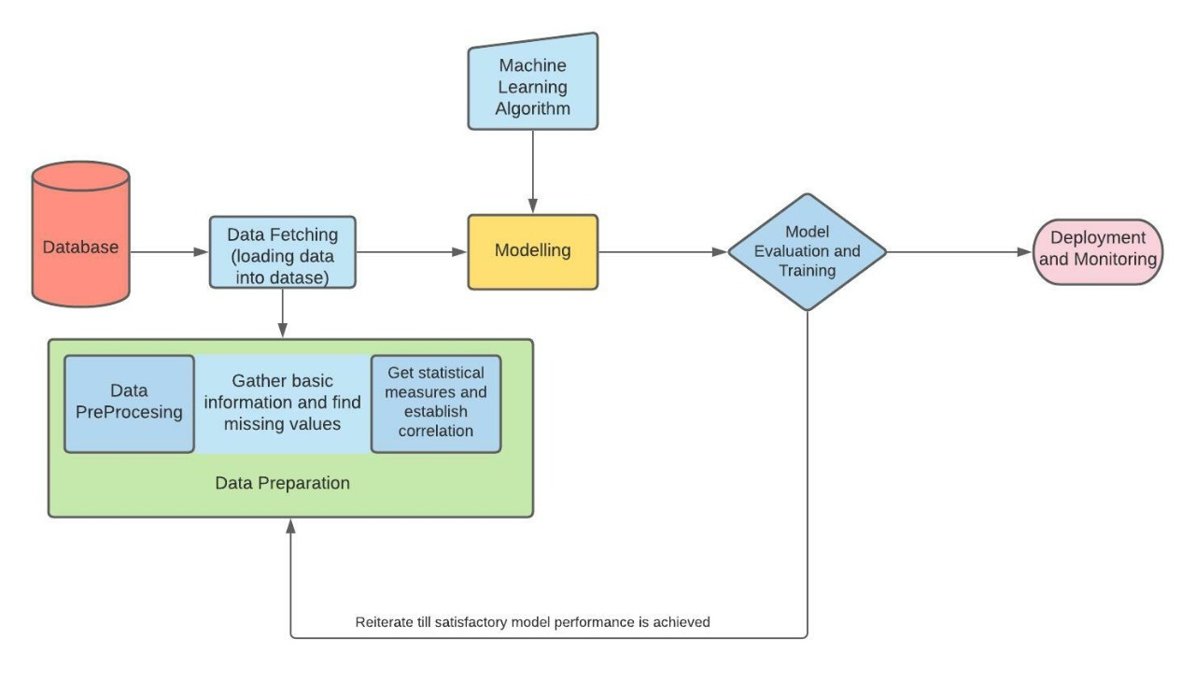
BLOCK DIAGRAM

Slide 8

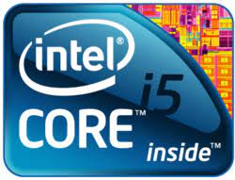
SYSTEM Specification
Windows 7/8/10
8 gigabytes storage
4 gigabytes RAM
Minimum intel i5 or equivalent

Slide 9


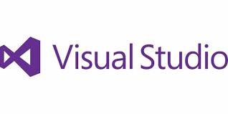

Software Specification
Python 3.8 or a stable version
Anaconda (Stable release)
Visual Studio Code
Java Development kit
Python Libraries
Atom (front-end dev)

Slide 10
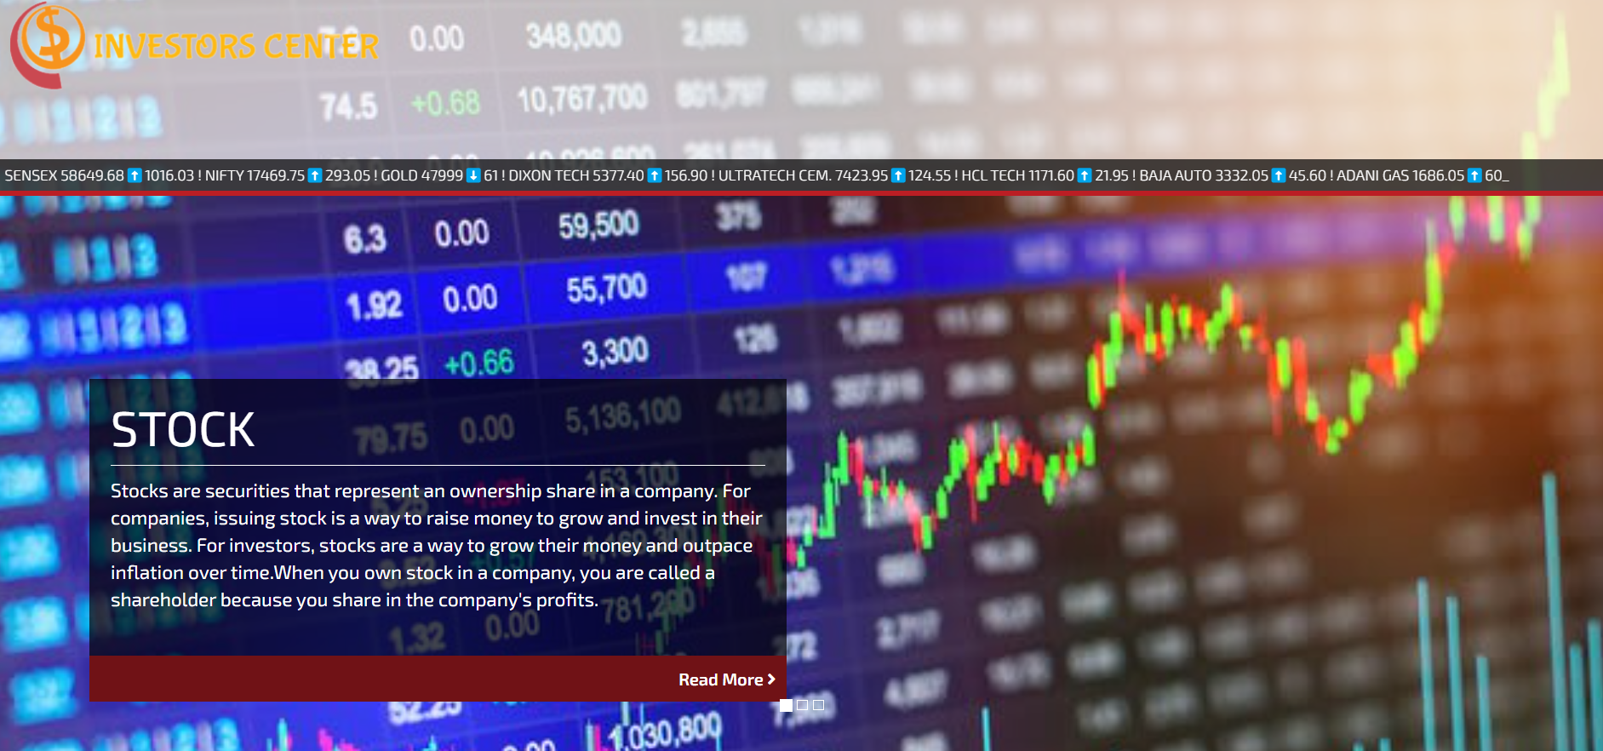
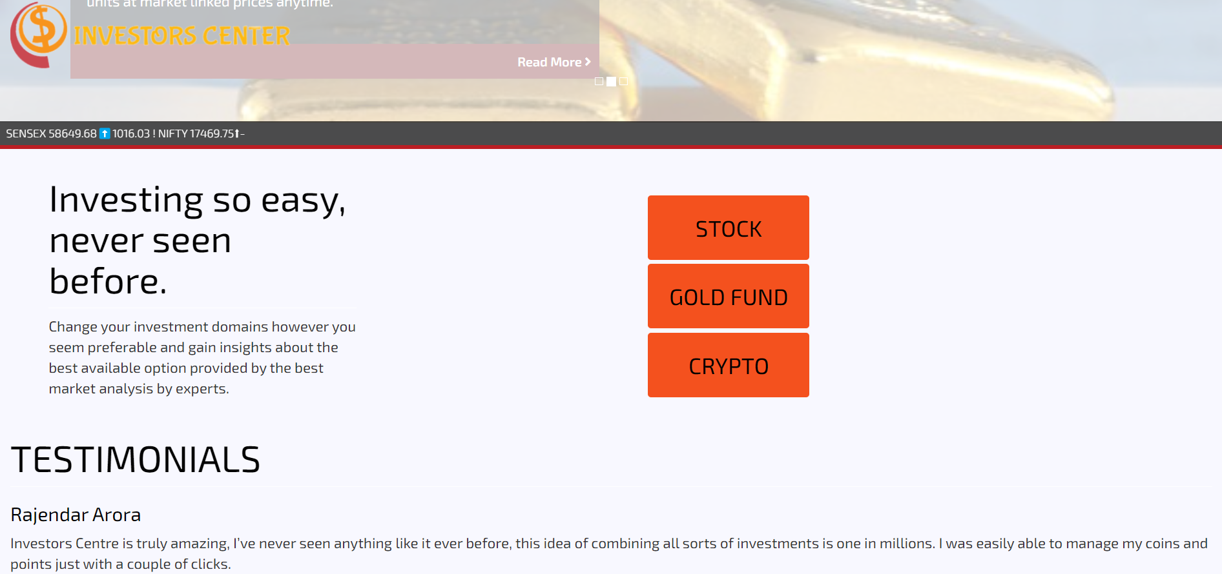
Front-end View

Slide 11
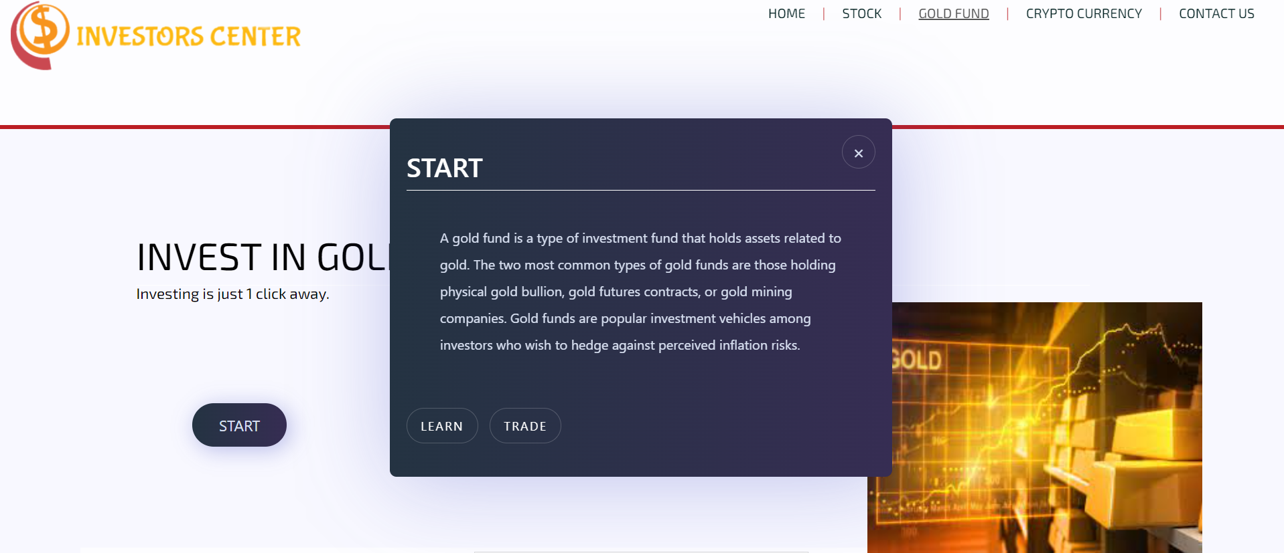
application

Slide 12

USER INPUT PAGE WHICH WILL PREDICT PRICE OF GOLD FUNDS

Slide 13
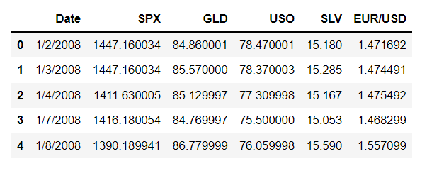
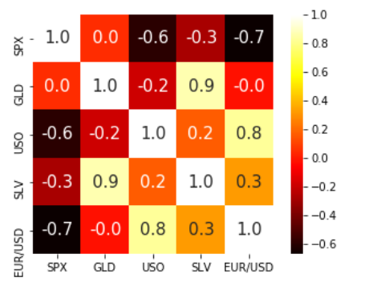
EXAMPLES ARE ALL WITH RESPECT TO THE PREDICTION OF GOLD PRICE STOCKS.
EXAMPLE OF THE DATA SET USED
HEATMAP TO UNDERSTAND THE CORRELATION OF DATA

Slide 14
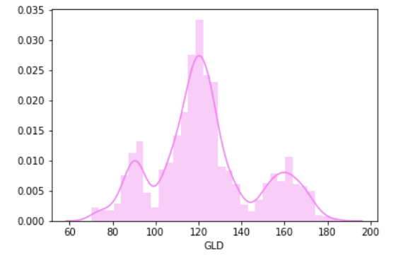
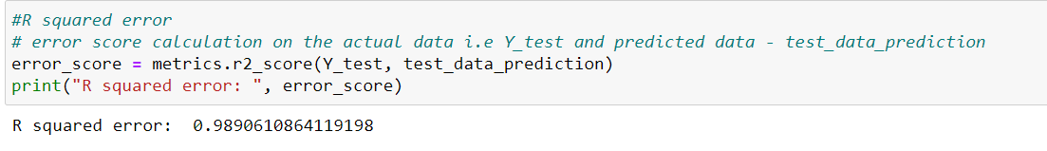
CHECKING DISTRIBUTION OF GOLD PRICE
R SQUARED ERROR

Slide 15
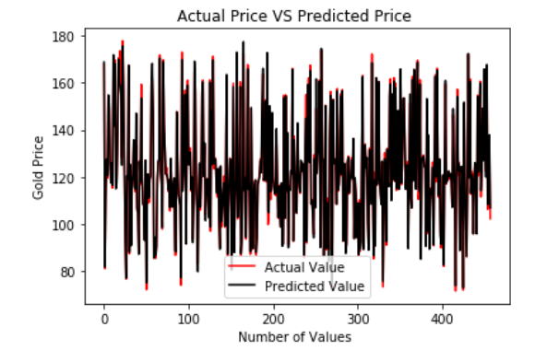
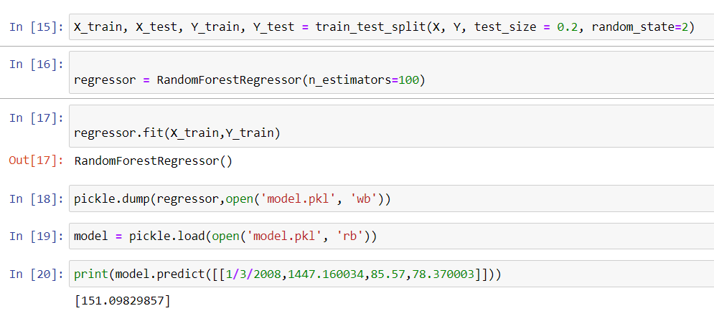
ACTUAL VS PREDICTED PRICE PLOTTING

Slide 16
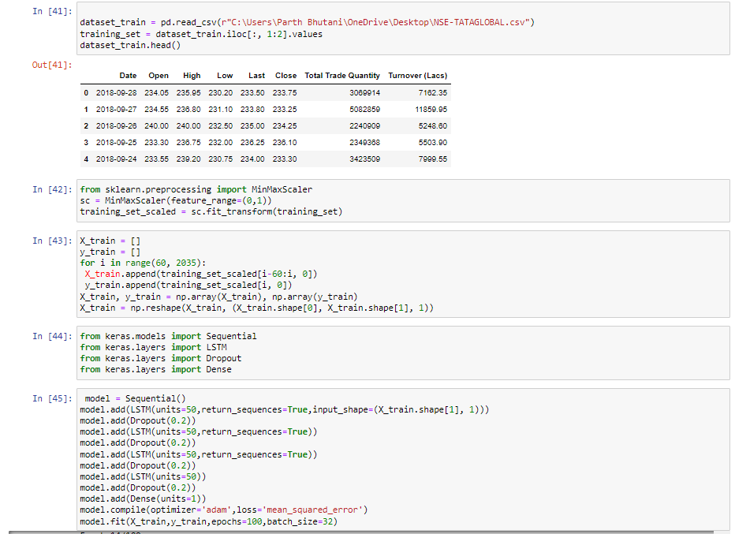
STOCK PREDICTION

Slide 17
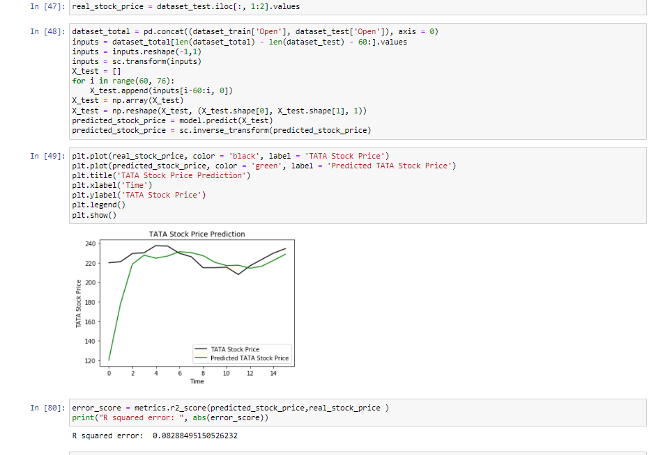

Slide 18
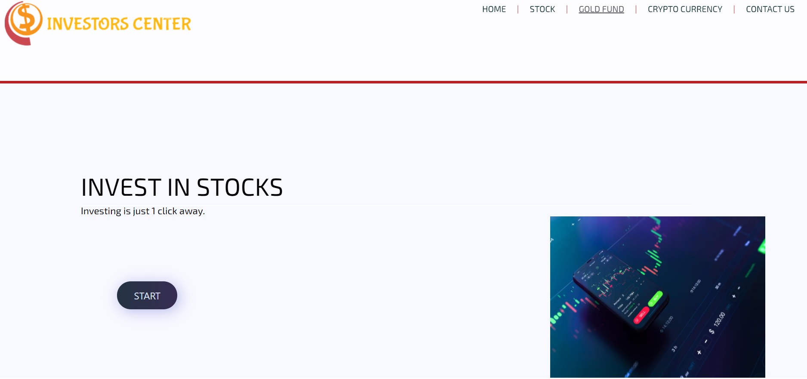

Slide 19
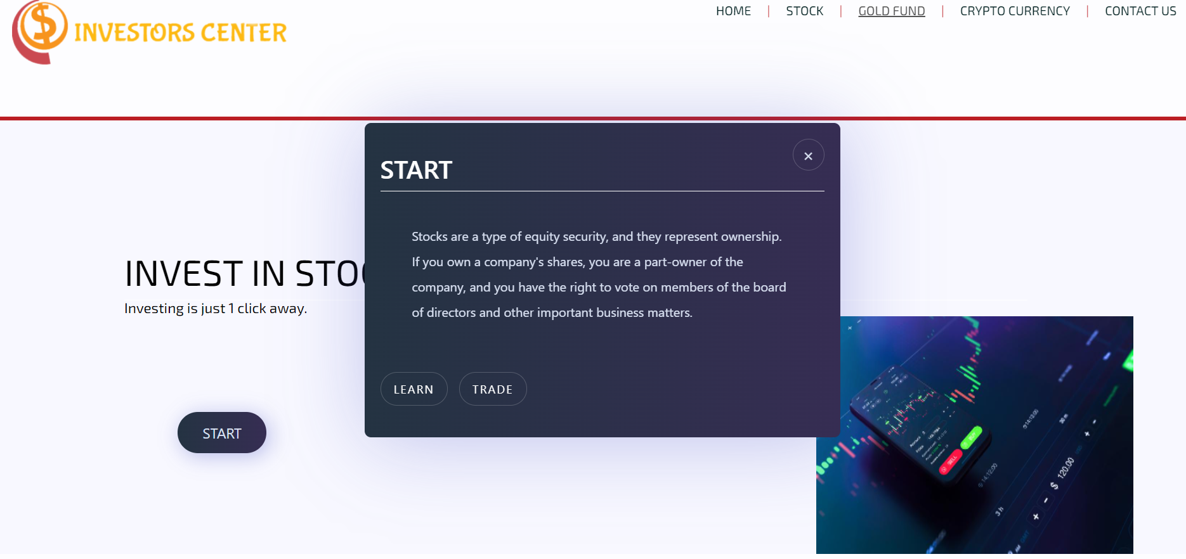

Slide 20
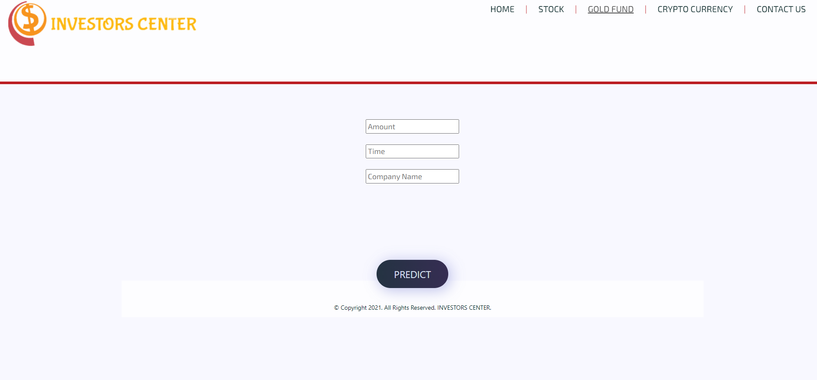
USER INPUT PAGE WHICH WILL PREDICT PRICE OF STOCKS

Slide 21
Scope of project
To bring a helpful user interface based on a finite number of investment opportunities deployed through a web/android application, our project is threefold
Firstly training and deploying a machine learning model.
Secondly developing a user interface with help of libraries such as flask, tkinter, django, etc. We are aiming at developing a web application from scratch.
Thirdly once the UI/web app is successfully implemented and up and running our next objective is to integrate it into an android application(APK).

Slide 22
conclusion
This model will be helpful for the future investors or those who are willing to start a career in investing.
With the help of our web based app , information about different types of investments will become easier for a rookie to access.

Slide 23
Bibliography and research paper references
Research Papers used for reference :
Authors : Z. Ismail, A. Yahya and A. Shabri
Title : Forecasting Gold Prices Using Multiple Linear Regression Method
Published in : American Journal of Applied Sciences
2) Authors : M.Sravani , Ch.Abhilash , T.Divya , Ch.Vasthav , D.Priyanka
Title : GOLD PRICE PREDICTION
Published in : International Journal of creative Research Thoughts , ISSN : 2320-2882
https://www.researchgate.net/profile/Temesgen-Muniye/publication/345262720_Bitcoin_Price_Prediction_and_Analysis_Using_Deep_Learning_Models/links/601bbe15299bf1cc26a01ea7/Bitcoin-Price-Prediction-and-Analysis-Using-Deep-Learning-Models.pdf?origin=publication_detail
3) https://www.researchgate.net/profile/Manjula-Ka/publication/336414732_Gold_Price_Prediction_using_Ensemble_based_Machine_Learning_Techniques/links/5f93d35a92851c14bce1a777/Gold-Price-Prediction-using-Ensemble-based-Machine-Learning-Techniques.pdf?origin=publication_detail
Dataset taken from
Kaggle

